Slide 1

Printable Programming

Slide 2
Course?
Visual thinking
Programming
Project Presentation

Slide 3
Background & Expectations
Programming experience not needed
Middle school math
2~4 hours/ week

Slide 4
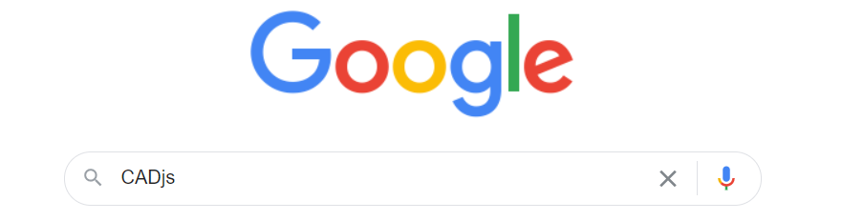
CADjs
Search for CADjs
https://ersl.wisc.edu/software/CADjs/CADjsFiles/CADjs.html

Slide 5
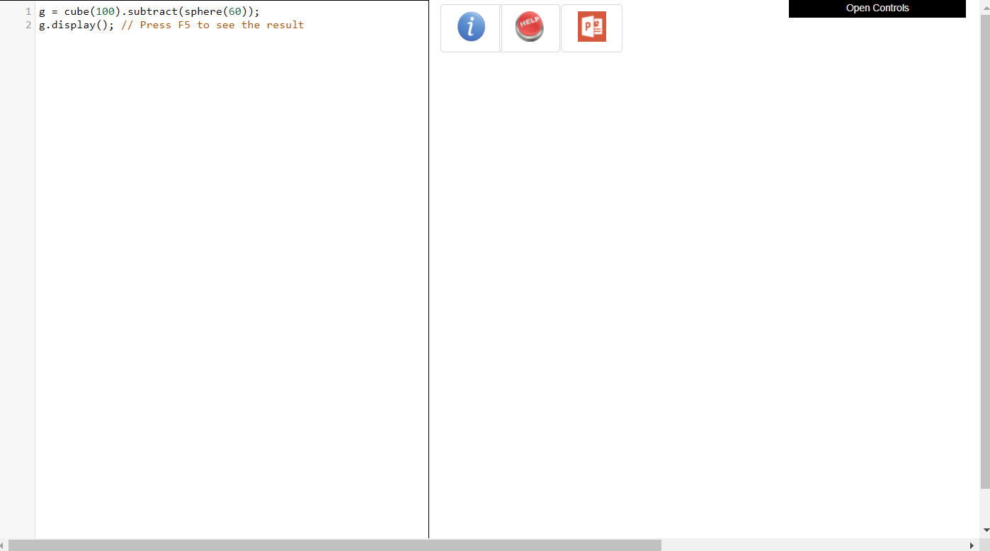
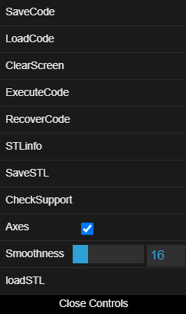
CADjs (Developed at UW)

Slide 6
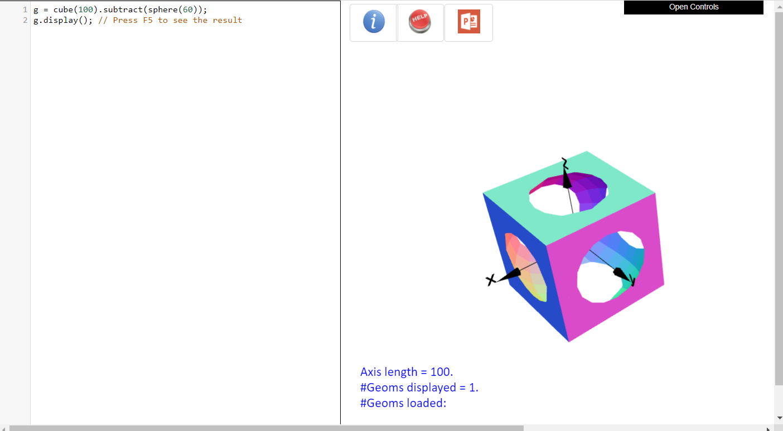
CADjs (Developed at UW)

Slide 7
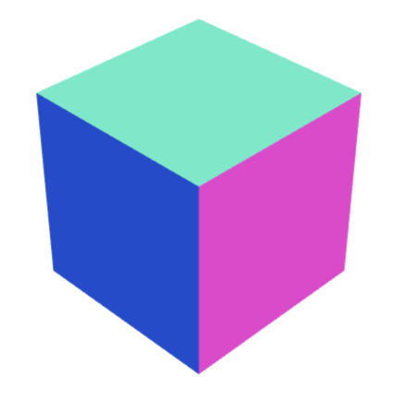
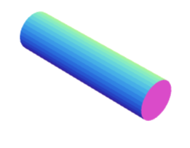

How?
(delete previous code)
Cube
cube(1).display();
(delete previous code)
Cylinder
cylinder(0.25,2).display();
(delete previous code)
Cube - Cylinder
g1 = cube(1);
g2 = cylinder(0.25,2);
g3 = g1.subtract(g2);
g3.display();

Slide 8

Example
Cube
Cylinder
…
Move the cylinder up
…
Cube - Cylinder
(delete previous code)
g1 = cube(1);
g2 = cylinder(0.25,2);
g2.moveZ(0.5);
g3 = g1.subtract(g2);
g3.display();

Slide 9
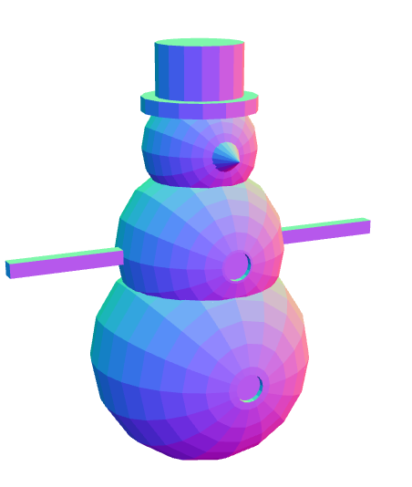
Example
Spheres
Cylinders
…
Move
…
Add, subtract
(learn later)

Slide 10
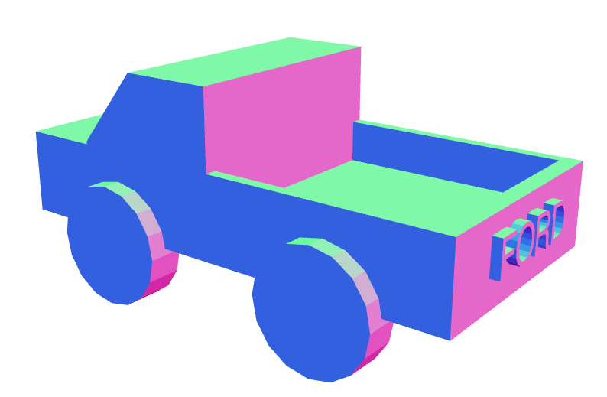
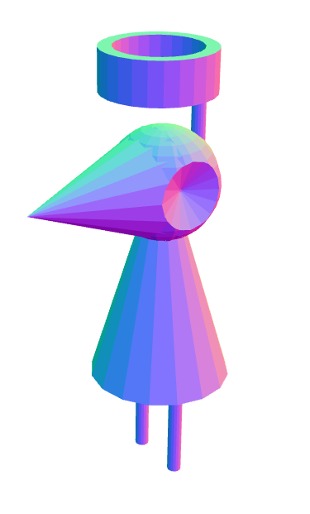
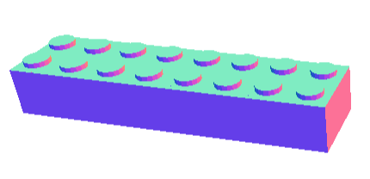
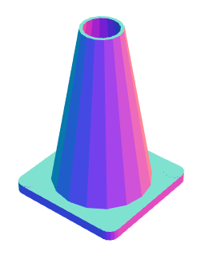
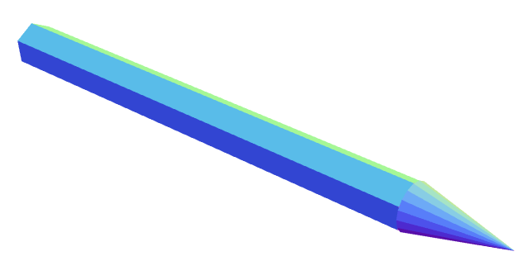
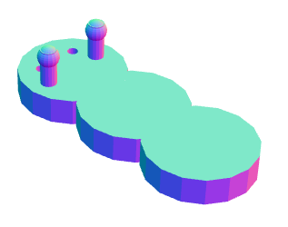
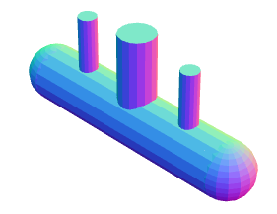

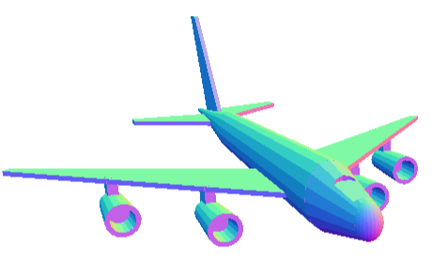
Sample Projects

Slide 11
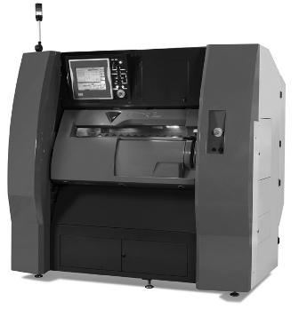
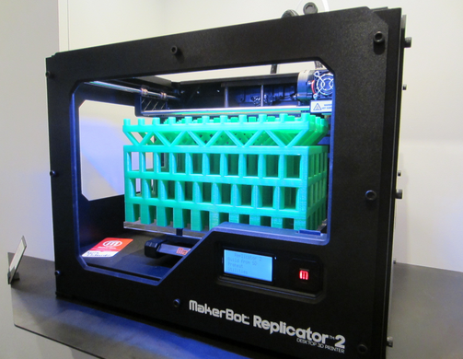
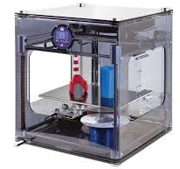
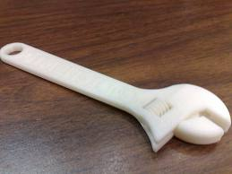
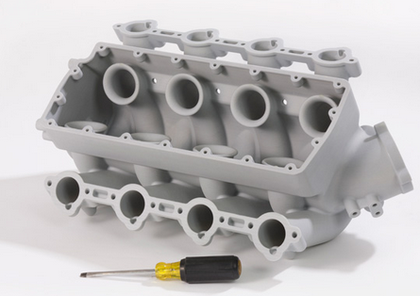
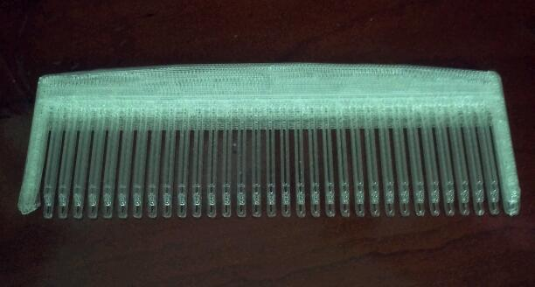
3D-Printing
Notes:
I am sure all of you have heard of 3D printing, or even seen a video of it. What do you think is the big deal about 3D printing? (Wait for response … encourage interaction)

Slide 12
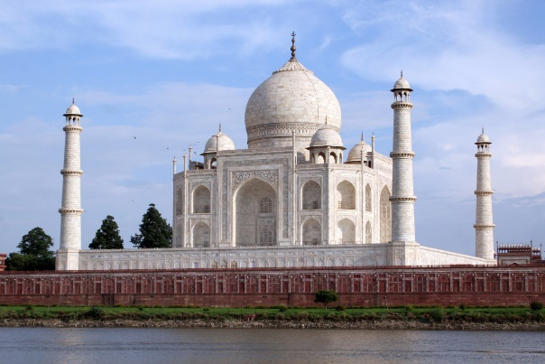
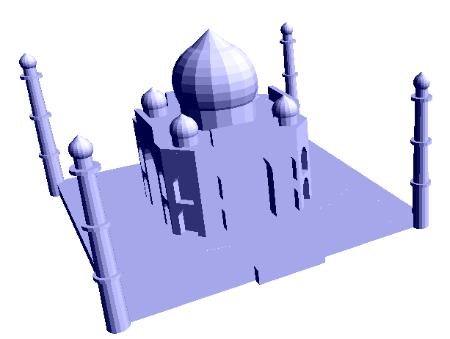
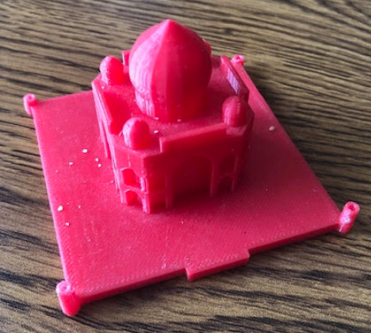
From Design to 3D Printed Model
Spheres,
Cylinders
Blocks,
…
Move
…
Add/subtract
//base of structure
Base=cube(100,5,100).translateY(-1).union(cube(22,5,8).translate(0,-1,49));
//pillars
Pillar=cone(3,2,50).translate(50,22.5,50).union(sphere(2.7).translate(50,49,50)).union(cone(1.7,0.1,1.5).translate(50,51.8,50)).union(cylinder(3.5,1.1).translate(50,14,50)).union(cylinder(3.5,1.1).translate(50,29,50)).union(cylinder(3.5,1.1).translate(50,44,50));
Pillar=Pillar.translateY(-1);
…
(250 lines)
Printable Programming

Slide 13

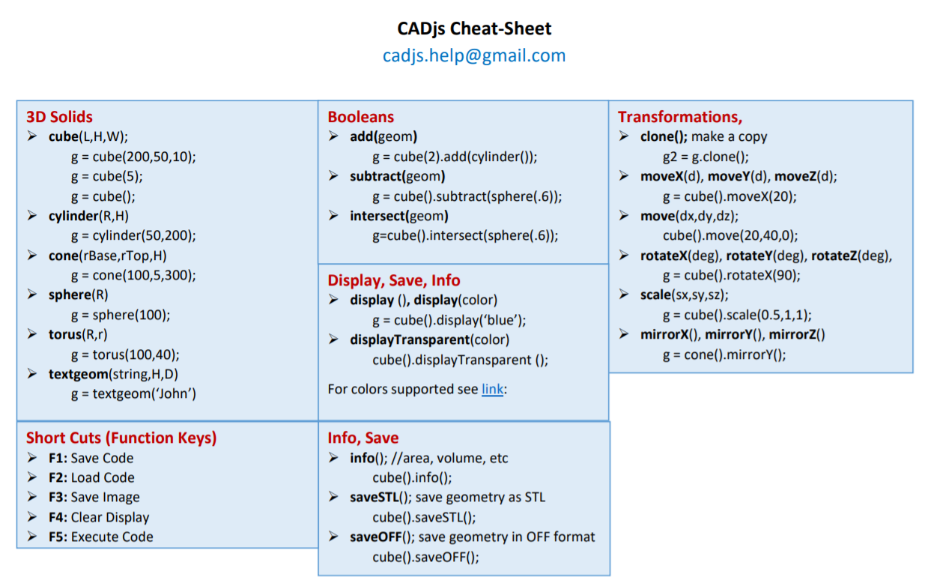
CADjs Cheat Sheet

