Slide 1
Printable Programming
Primitives

Slide 2
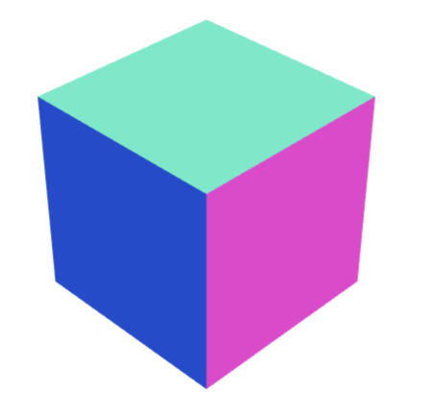
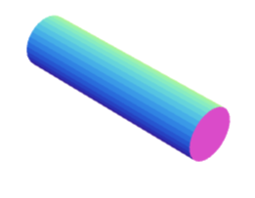
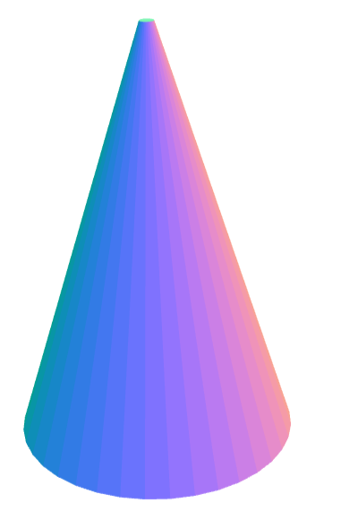
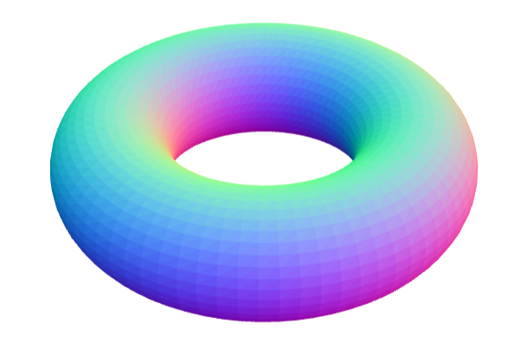
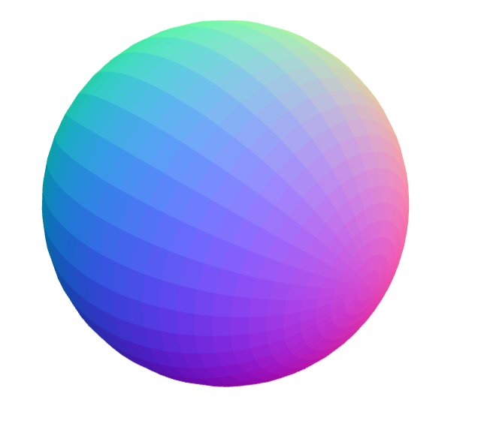
5 Building Blocks
Cube
Cylinder
Sphere
Cone
Torus

Slide 3
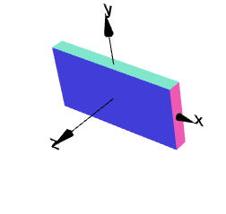
Cube
Create a cuboid of dimensions 10 x 5 x 1
g=cube(10,5,1);
g.display();

Slide 4
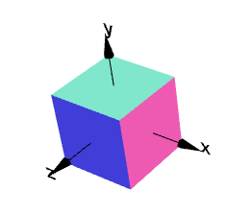
Variables
a=10;
b=5;
c=1;
g1=cube(a,b,c);
g1.display();

Slide 5
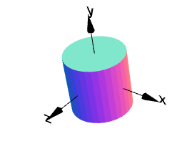
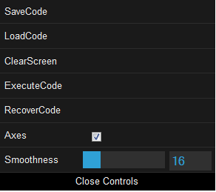
Cylinder
radius = 1.0;
height = 2.0;
g = cylinder(radius,height);
g.display();
Increase smoothness

Slide 6
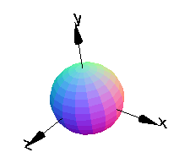
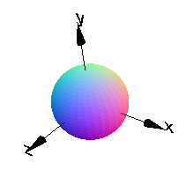
Sphere
g=sphere(1);
g.display();
Can increase quality for smoothness

Slide 7
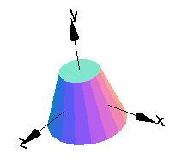
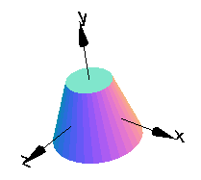
Cone
g=cone(2,1,3);
g.display();
g=cone(2,1,3);
g.display();

Slide 8
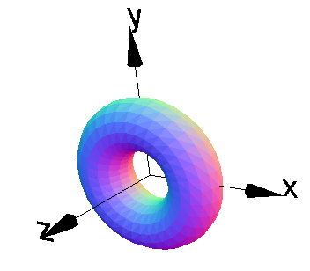
Torus
g=torus(2,1);
g.display();

Slide 9
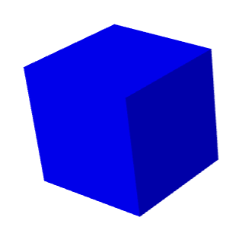
Display Color
g = cube(1);
g.display('blue');
Others:
Red, green, yellow
Magenta, teal, chocolate, …

Slide 10
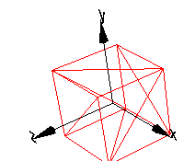
Display Transparent
g = cube(1);
g.displayTransparent();

Slide 11
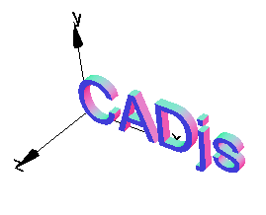
Program for your name
Enter:
g = textGeom("CADjs");
g.display();

Slide 12
Area and Volume
g = cube(1);
g.display();
What is the total area (add all 6 sides)?
What is the volume?

Slide 13
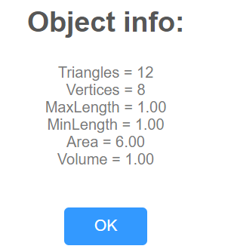
Area and Volume
g = cube(1);
g.info();
g.display();
Area = 6
Volume = 1

Slide 14
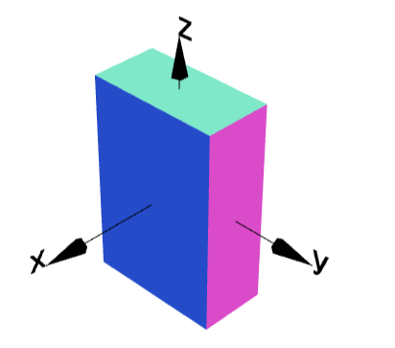
Area and Volume
g = cube(1,2,3);
g.display();
Area = ?
Volume = ?

Slide 15
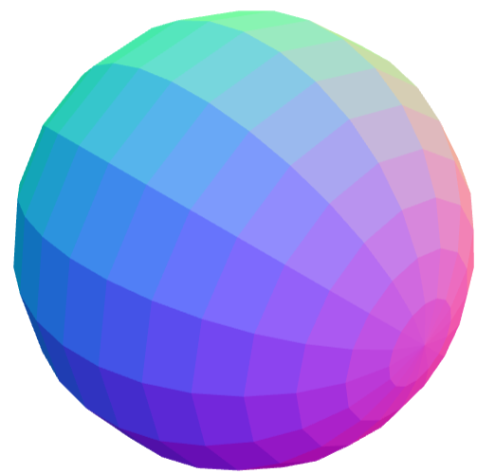
Area and Volume
g = sphere(1);
g.display();
Area = ?
Volume = ?

