Slide 1
Printable Programming
Booleans

Slide 2
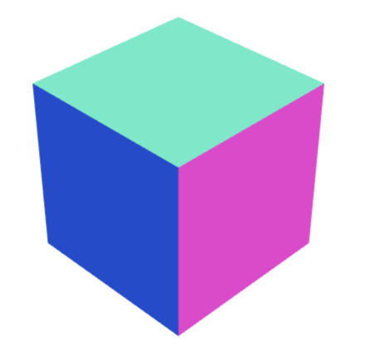
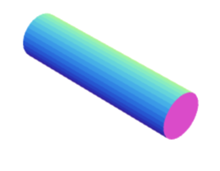
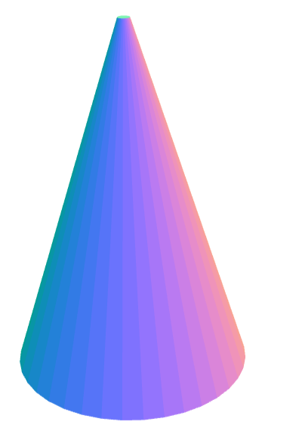
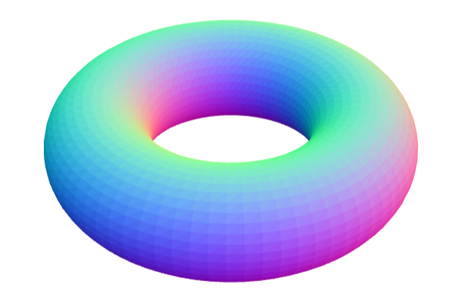
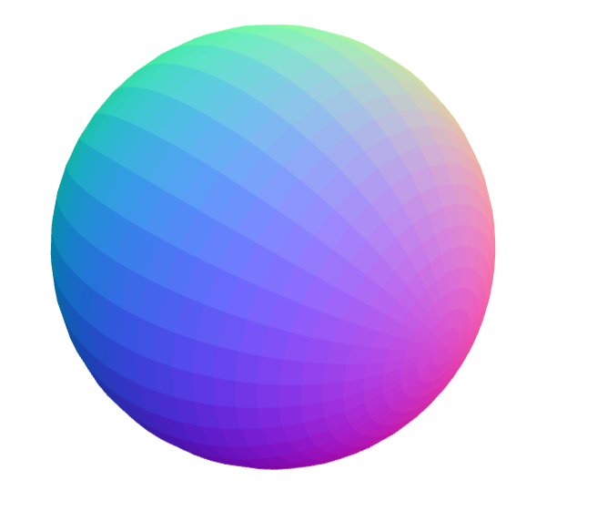
Learnt
Cube
Cylinder
Sphere
Cone
Torus

Slide 3
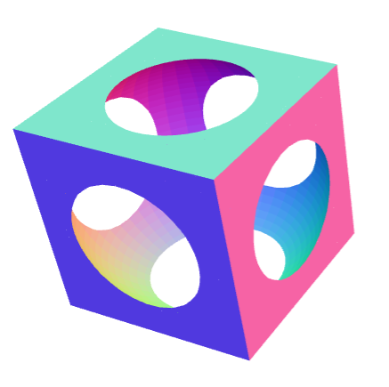
Question

Slide 4
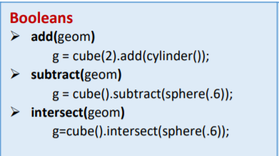
Booleans

Slide 5
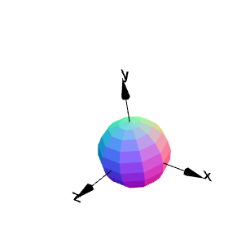
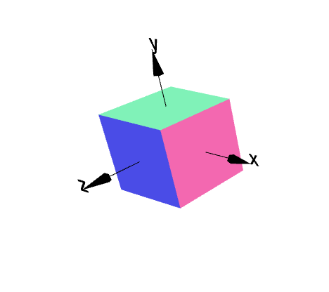
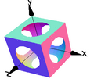
Subtraction
g1=cube(1);
g2=sphere(.6);
g3=g1.subtract(g2);
g3.display();

Slide 6
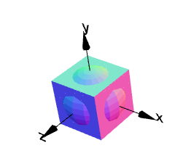
Addition
g1=cube(1);
g2=sphere(.6);
g3=g1.add(g2);
g3.display();

Slide 7
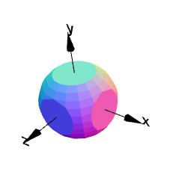
Intersection
g1=cube(1);
g2=sphere(.6);
g3=g1.intersect(g2);
g3.display();

Slide 8
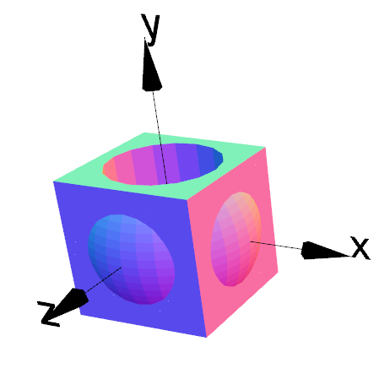
Question
3 solids?
Boolean operations?

Slide 9
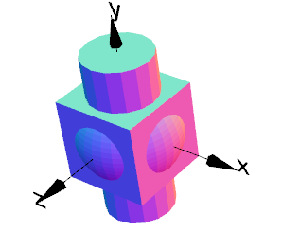
Hint
g1 = cube(1);
g2 = sphere(0.6);
g3 = cylinder(0.4,2);
g1.display();
g2.display();
g3.display();

Slide 10
Solution
g1 = cube(1);
g2 = sphere(0.6);
g3 = cylinder(0.4,2);
g4 = g1.add(g2);
g5 = g4.subtract(g3);
g5.display();

Slide 11
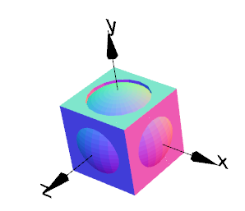
Order matters
g1 = cube(1);
g2 = sphere(0.6);
g3 = cylinder(0.4,2);
g4 = g1.add(g2);
g5 = g4.subtract(g3);
g5.display();
Order of Boolean Operations matters!
g1 = cube(1);
g2 = sphere(0.6);
g3 = cylinder(0.4,2);
g4 = g1.subtract(g3);
g5 = g4.add(g2);
g5.display();

Slide 12
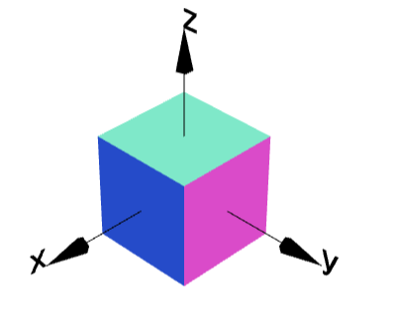
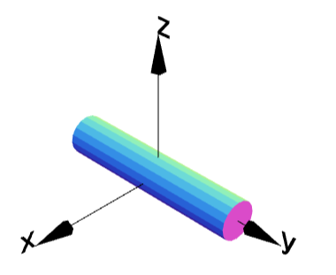
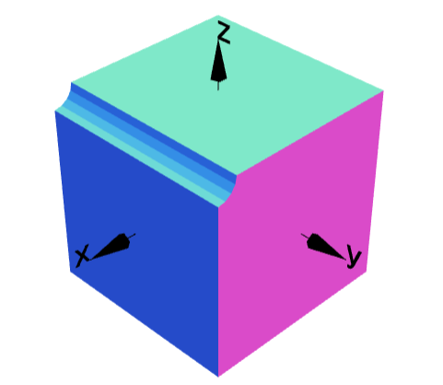
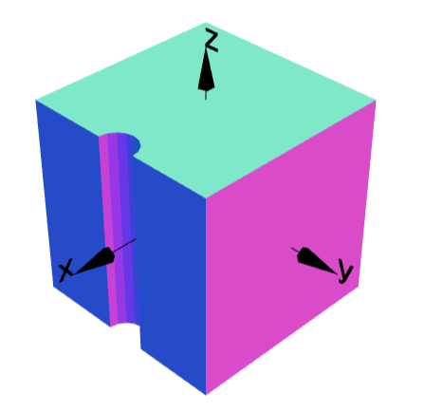
Cylinder and Cube
myCylinder = cylinder(0.1,1);
myCube= cube(1);
1
2

Slide 13
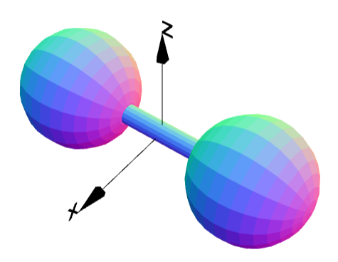
Cylinder and Spheres
myCylinder = cylinder(0.1,1);
mySphere= sphere(0.6);

Slide 14
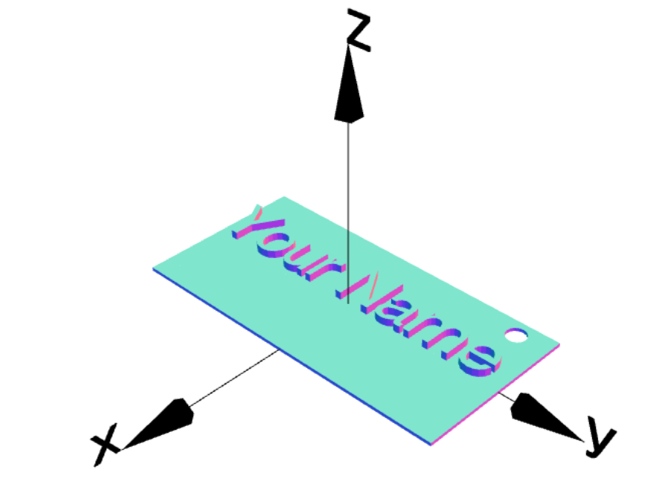
Personalized Name Plate
plate = cube(5,10,0.1);

Slide 15
Personalized Name Plate
plate = cube(5,10,0.1);
myName = textGeom("Your Name",1.4);
myName = myName.rotateZ(90).moveY(-5);
hole = cylinder(0.3,1).rotateX(90).move(-2,4,0);
myNamePlate = plate.add(myName);
myNamePlate = myNamePlate.subtract(hole);
myNamePlate.display();

