Slide 1

Printable Programming
Good Coding Practice

Slide 2
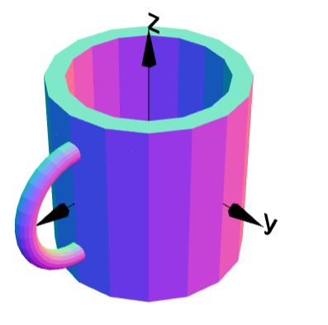
Example: Mug
g1 = cylinder(0.4,0.7).moveY(0.2);
g2 = cylinder(0.5,1.0);
g3 = torus(0.3,0.05).moveX(0.5);
g4 = g2.add(g3);
g4 = g4.subtract(g1);
g4.rotateX(90);
g4.display();
Code works fine, but …
How to change thickness of handle?
How to change thickness of cup?
Code is hard to understand and modify

Slide 3
Big Projects
"w" => "[0-9]+%?",
"h" => "[0-9]+%?",
"x" => "[0-9]+",
"y" => "[0-9]+",
"t" => "jpg|png",
"q" => "1?[0-9]{1,2}" );
// check tags and save correct values in array
for ($i=0; $i
if (isset($check[$matches[$i][2]])) {
if (preg_match('/^('.$check[$matches[$i][2]].')$/',
$matches[$i][3])) {
$tags[$matches[$i][2]] = $matches[$i][3];
}
}
}
function notfound() {
header("HTTP/1.0 404 Not Found");
exit;
}
// check that filename is given
if (!isset($tags["f"])) {
notfound();
}
// check if file exists
if (!file_exists($base_img_dir.$tags["f"])) {
notfound();
}
// retrieve file info
$imginfo = getimagesize($base_img_dir.$tags["f"]);
// load image
switch ($imginfo[2]) {
case 2: // jpg
$img_in = imagecreatefromjpeg($base_img_dir.$tags["f"]) or notfound();
if (!isset($tags["t"])) {
$tags["t"] = "jpg";
}
break;
case 3: // png
$img_in = imagecreatefrompng($base_img_dir.$tags["f"]) or notfound();
if (!isset($tags["t"])) {
$tags["t"] = "png";
}
break;
default:
notfound();
}
// check for maximum width and height
if (isset($tags["x"])) {
if ($tags["x"] < imagesx($img_in)) {
$tags["w"] = $tags["x"];
}
}
if (isset($tags["y"])) {
if ($tags["y"] < imagesy($img_in)) {
$tags["h"] = $tags["y"];
}
}
// check for need to resize
if (isset($tags["h"]) or isset($tags["w"])) {
// convert relative to absolute
if (isset($tags["w"])) {
if (strstr($tags["w"], "%")) {
$tags["w"] = (intval(substr($tags["w"], 0, -1)) / 100) *
$imginfo[0];
}
}
if (isset($tags["h"])) {
if (strstr($tags["h"], "%")) {
$tags["h"] = (intval(substr($tags["h"], 0, -1)) / 100) *
$imginfo[1];
}
}
// resize
if (isset($tags["w"]) and isset($tags["h"])) {
$out_w = $tags["w"];
$out_h = $tags["h"];
} elseif (isset($tags["w"]) and !isset($tags["h"])) {
$out_w = $tags["w"];
$out_h = $imginfo[1] * ($tags["w"] / $imginfo[0]);
} elseif (!isset($tags["w"]) and isset($tags["h"])) {
$out_w = $imginfo[0] * ($tags["h"] / $imginfo[1]);
$out_h = $tags["h"];
} else {
$out_w = $tags["w"];
$out_h = $tags["h"];
}
// new image in $img_out
$img_out = imagecreate($out_w, $out_h);
imagecopyresized($img_out, $img_in, 0, 0, 0, 0, imagesx($img_out),
imagesy($img_out), imagesx($img_in), imagesy($img_in));
} else {
// no resize needed
$img_out = $img_in;
}
// check for a given jpeg-quality, otherwise set to default
if (!isset($tags["q"])) {
$tags["q"] = 75;
}
// returning the image
switch ($tags["t"]) {
case "jpg":
header("Content-type: image/jpeg");
imagejpeg($img_out, "", $tags["q"]);
exit;
case "png":
header("Content-type: image/png");
imagepng($img_out);
exit;
default:
notfound();
Impossible to understand!

Slide 4
Tips
Use Comments and good variable names:
Code easy to follow
Easily to edit code

Slide 5
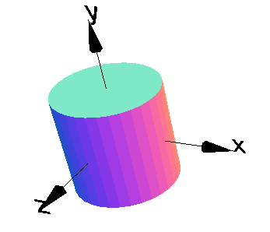
Numbers
g = cylinder(1,2,32);
g.display();
Numbers 1,2 and 32 are hard to understand.

Slide 6
Naming Numbers
Name them “radius,” “height” and “quality”
radius = 1;
height = 2;
quality = 32
g = cylinder(radius,height,quality);
g.display();

Slide 7
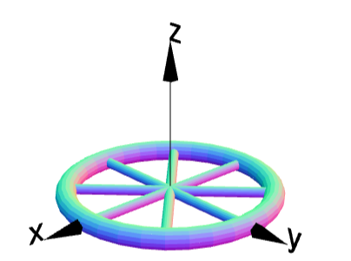
Wheel
g = torus(1,0.1);
g1 = cylinder(0.05,2);
g2 = cylinder(0.05,2).rotateZ(45);
g3 = cylinder(0.05,2).rotateZ(90);
g4 = cylinder(0.05,2).rotateZ(135);
g = g.add(g1).add(g2).add(g3).add(g4);
g.display();
Object names g, g1, g2 … not a great choice

Slide 8
Naming objects
wheel = torus(1,0.1);
spoke1 = cylinder(0.05,2);
spoke2 = cylinder(0.05,2).rotateZ(45);
spoke3 = cylinder(0.05,2).rotateZ(90);
spoke4 = cylinder(0.05,2).rotateZ(135);
finalWheel = wheel.add(spoke1).add(spoke2);
finalWheel = finalWheel.add(spoke3).add(spoke4);
finalWheel.display();
Using appropriate names for objects

Slide 9
Naming objects and numbers
wheelRadius = 1;
wheelThickness = 0.1;
spokeLength = 2;
spokeRadius = 0.05;
wheel = torus(wheelRadius, wheelThickness);
spoke1 = cylinder(spokeRadius, spokeLength);
spoke2 = cylinder(spokeRadius, spokeLength).rotateZ(45);
spoke3 = cylinder(spokeRadius, spokeLength).rotateZ(90);
spoke4 = cylinder(spokeRadius, spokeLength).rotateZ(135);
finalWheel = wheel.add(spoke1).add(spoke2);
finalWheel = add(spoke3).add(spoke4);
finalWheel.display();
Code is longer but easier to understand

Slide 10
Dependent numbers
wheelRadius = 1;
wheelThickness = 0.1;
spokeLength = 2*wheelRadius;
spokeRadius = wheelThickness/2;
wheel = torus(wheelRadius, wheelThickness);
spoke1 = cylinder(spokeRadius, spokeLength);
spoke2 = cylinder(spokeRadius, spokeLength).rotateZ(45);
spoke3 = cylinder(spokeRadius, spokeLength).rotateZ(90);
spoke4 = cylinder(spokeRadius, spokeLength).rotateZ(135);
finalWheel = wheel.add(spoke1).add(spoke2);
finalWheel = add(spoke3).add(spoke4);
finalWheel.display();
Use minimum number of variables

Slide 11
Comments
Purpose of Comments
Adds clarity to your code
Allows you to look up lines of code easily
To add a comment:
Simply add // after your code
Follow this by your comment
Comments do not affect the actual code

Slide 12
Comments
Example: Simple Cylinder
  radius = 1.0; //radius of cylinder
  height = 2.0; //height of cylinder
  g = cylinder(radius,height,32); //creates cylinder g
  g.display(); //displays cube
Good Comment Practice
Keep your comments short and to the point
Comment any line which needs clarity

Slide 13
Example: Mug
g1 = cylinder(0.4,0.7).moveY(0.2);
g2 = cylinder(0.5,1.0);
g3 = torus(0.3,0.05).moveX(0.5);
g4 = g2.add(g3);
g4 = g4.subtract(g1);
g4.rotateX(90);
g4.display();
Name the objects
Name the variables
Add comments

