Slide 1

Printable Programming
Polygons

Slide 2
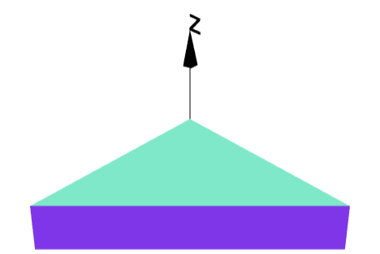
Wedge
How to create?

Slide 3
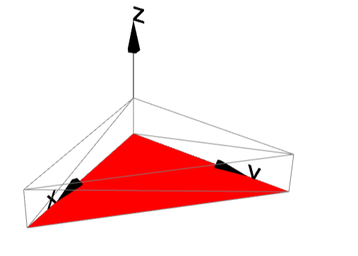
Wedge
Create 2D shape
Extrude

Slide 4
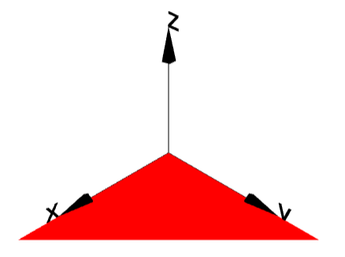
Polygon
3 points
(0,0)
(1,0)
(0,1)
s=polygon([ [0,0],[1,0],[0,1] ]);
s.display();
Create a polygon with 3 points.

Slide 5
Sweep
s=polygon([ [0,0],[1,0],[0,1] ]);
g = extrudeShape(s, 0.25);
g.display();

Slide 6
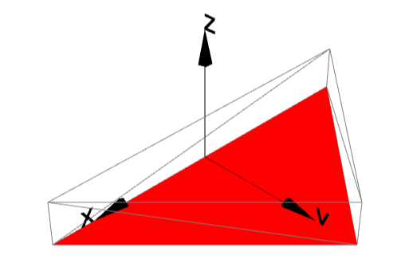
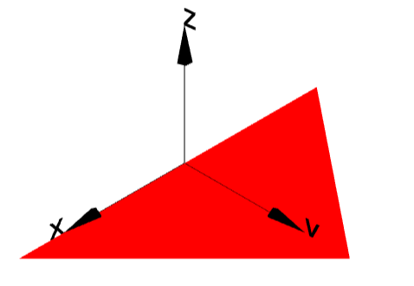
Sweep
(-1,0)
(1,0)
(0,1)
3 points
s=polygon([ [-1,0],[1,0],[0,1] ]);
g = extrudeShape(s, 0.25);
g.display();

Slide 7
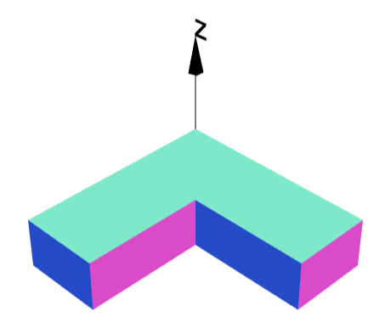
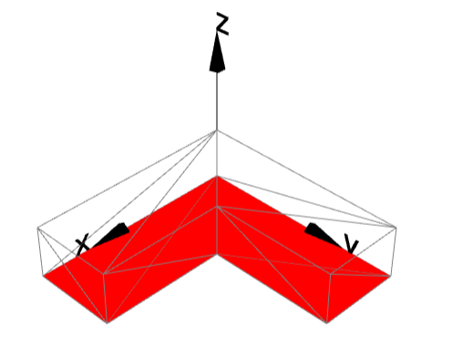
L-Block

Slide 8
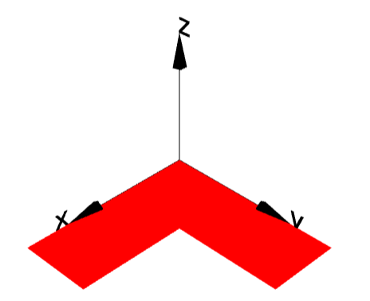
L-Block
 | x | y
1 | 0 | 0
2 | 1 | 0
3 | 1 | 0.4
4 | 0.4 | 0.4
5 | 0.4 | 1
6 | 0 | 1
1
2
4
6
3
5
s=polygon([ [0,0],[1,0],[1,0.4],[0.4,0.4],[0.4,1],[0,1] ]);
s.display();

Slide 9
L-Block
s=polygon([ [0,0],[1,0],[1,0.4],[0.4,0.4],[0.4,1],[0,1]]);
g = extrudeShape(s, 0.25);
g.display();

Slide 10
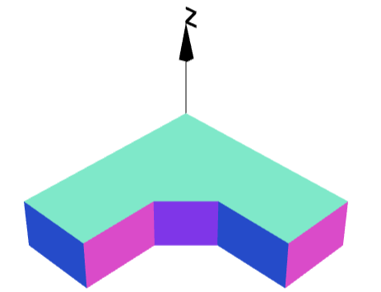
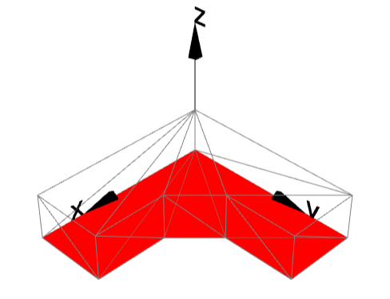
L-Block

Slide 11
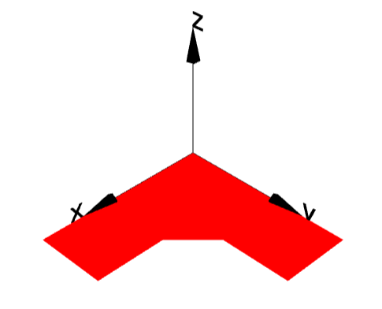
Exercise - Extrude
 | x | y
1 | 0 | 0
2 | 1 | 0
3 | 1 | 0.4
4 | 0.6 | 0.4
5 | 0.4 | 0.6
6 | 0.4 | 1
7 | 0 | 1
1
2
5
7
4
3
6
s=polygon([ [0,0],[1,0],[1,0.4],[0.6,0.4],[0.4,0.6],[0.4,1],[0,1] ]);
s.display();

Slide 12
L-Block
s=polygon([ [0,0],[1,0],[1,0.4],[0.6,0.4],[0.4,0.6],[0.4,1],[0,1] ]);
g = extrudeShape(s, 0.25);
g.display();

Slide 13
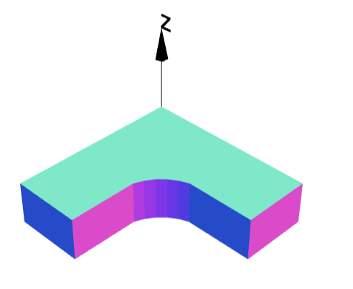
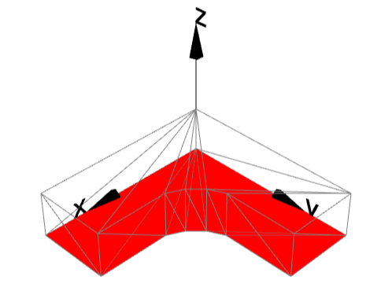
L-Block with Arc

Slide 14
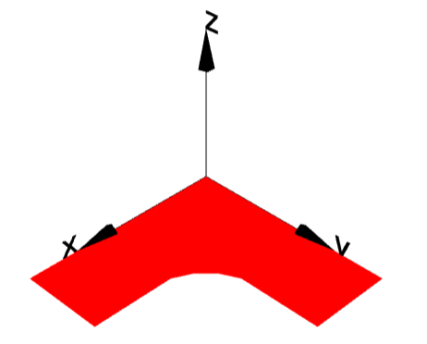
L-Block with Arc
 | x | y | radius
1 | 0 | 0
2 | 1 | 0
3 | 1 | 0.4
4 | 0.6 | 0.4
5 | 0.4 | 0.6 | 0.3
6 | 0.4 | 1
7 | 0 | 1
1
2
5
7
4
3
6
s=polygon([ [0,0],[1,0],[1,0.4],[0.6,0.4],[0.4,0.6,0.3],[0.4,1],[0,1] ]);
s.display();

Slide 15
L-Block
s=polygon([ [0,0],[1,0],[1,0.4],[0.6,0.4],[0.4,0.6,0.3],[0.4,1],[0,1] ]);
g = extrudeShape(s, 0.25);
g.display();

Slide 16
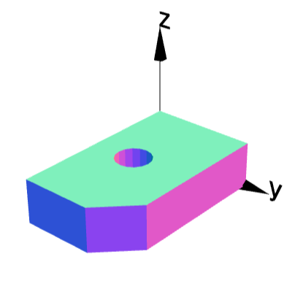
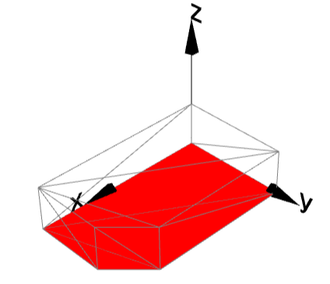
Combine with Booleans

Slide 17
Combine with Booleans
s=polygon([ [0,0],[2,0],[2,0.8],[1.6,1.2],[0,1.2]]);
g = extrudeShape(s, 0.5);
g2 = cylinder(0.2,2).rotateX(90).move(1,0.5,0);
g = g.subtract(g2);
g.display();
Create polygon
Extrude
Subtract cylinder

Slide 18
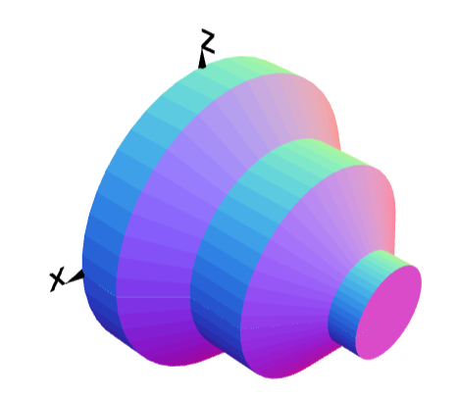
Axi Symmetric Parts

Slide 19


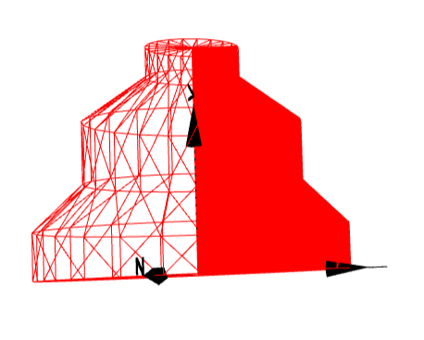
Axi-Symmetric Parts

Slide 20
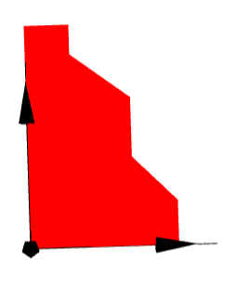
Revolve
 | x | y
1 | 0 | 0
2 | 10 | 0
3 | 10 | 3
4 | 7 | 6
5 | 7 | 10
6 | 3 | 13
7 | 3 | 15
8 | 0 | 15
8
7
6
5
4
3
1
2
s=polygon([ [0,0],[10,0],[10,3],[7,6],[7,10],[3,13],[3,15],[0,15]]);
s.display();

Slide 21
Revolve
s=polygon([ [0,0],[10,0],[10,3],[7,6],[7,10],[3,13],[3,15],[0,15]]);
g = revolveShape(s);
g.display();

Slide 22
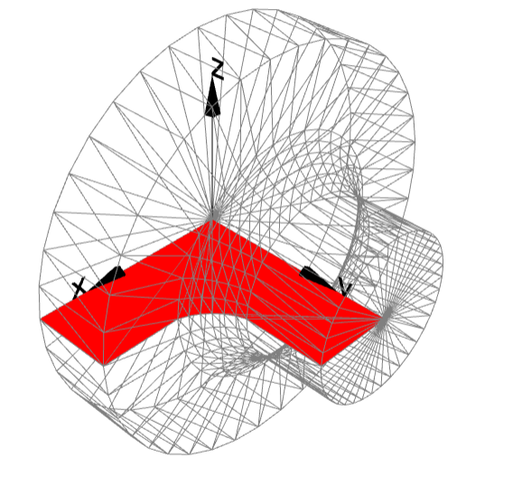
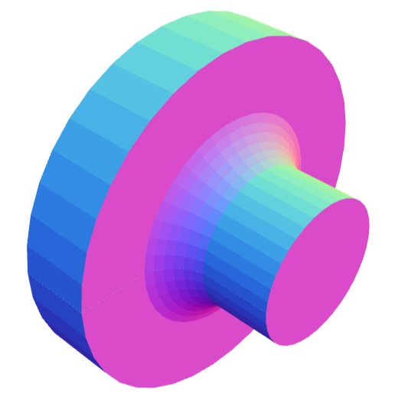
Axi-Symmetric Parts

Slide 23
L-Block with Arc
 | x | y | radius
1 | 0 | 0
2 | 1 | 0
3 | 1 | 0.4
4 | 0.6 | 0.4
5 | 0.4 | 0.6 | 0.3
6 | 0.4 | 1
7 | 0 | 1
1
2
5
7
4
3
6
s=polygon([ [0,0],[1,0],[1,0.4],[0.6,0.4],[0.4,0.6,0.3],[0.4,1],[0,1] ]);
s.display();

Slide 24
Axi-Symmetric Parts
s=polygon([ [0,0],[1,0],[1,0.4],[0.6,0.4],[0.4,0.6,0.3],[0.4,1],[0,1] ]);
g = revolveShape(s);
g.display();

Slide 25
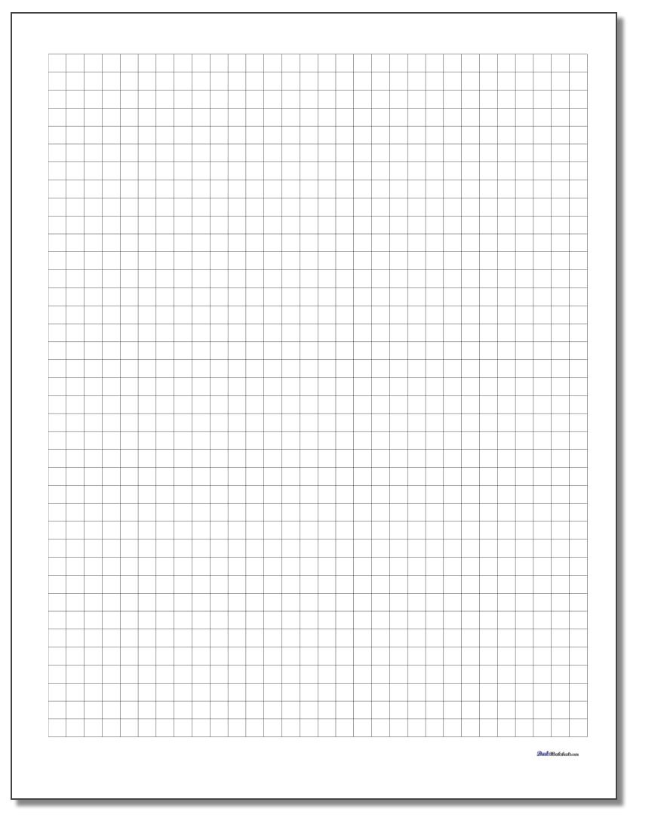

Using Graph Sheets

