Slide 1

Printable Programming
Engineering Drawings

Slide 2
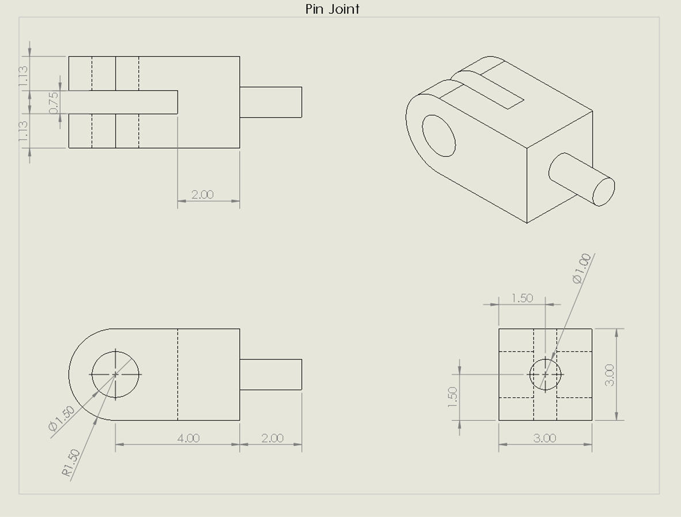
Engineering Drawing
Engineering drawings are comprised of:
Multiple views (Usually four)
All important features must be dimensioned
Must be intuitive to read with no ambiguity

Slide 3
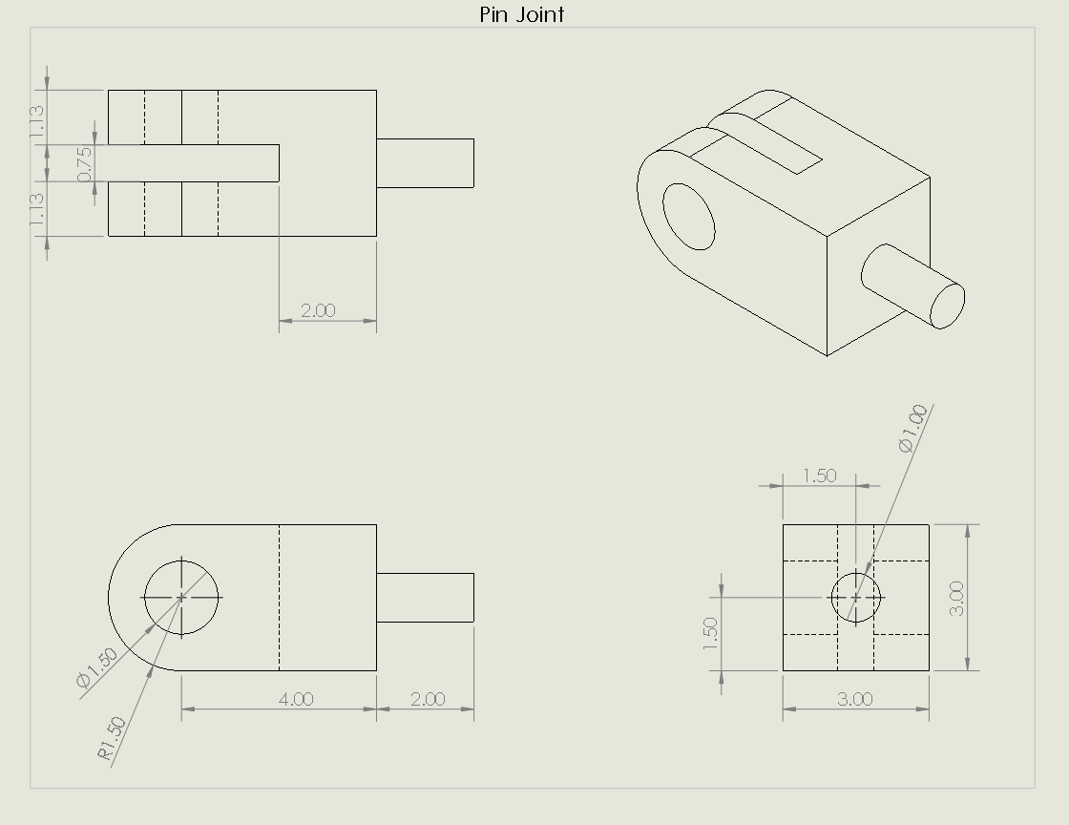
Example: Pin Joint

Slide 4
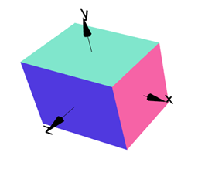
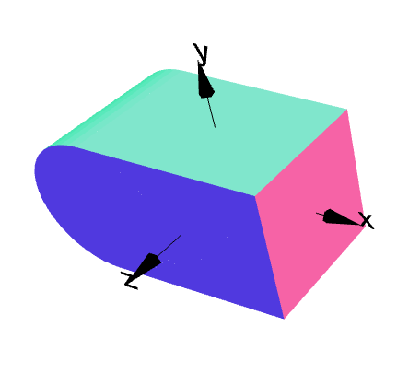
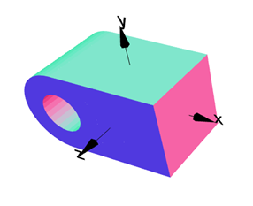
Example: Pin Joint
Step 1: Create Cube
Step 2: Add Cylinder
Step 3: Remove Hole

Slide 5
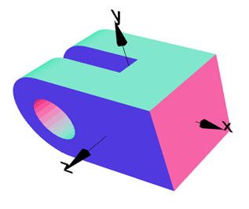
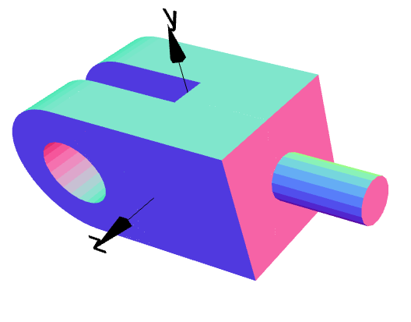
Example: Pin Joint
Step 4: Remove Slot
Step 5: Add Pin
Done!

Slide 6
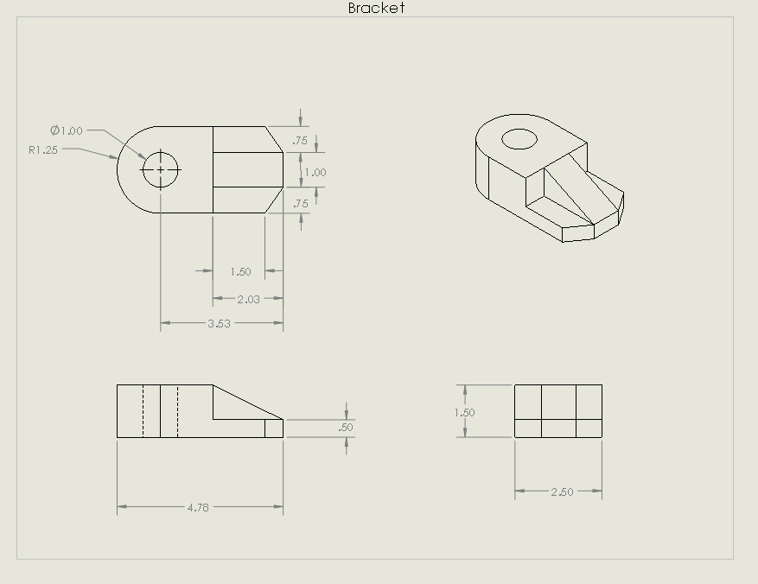
Exercise

Slide 7
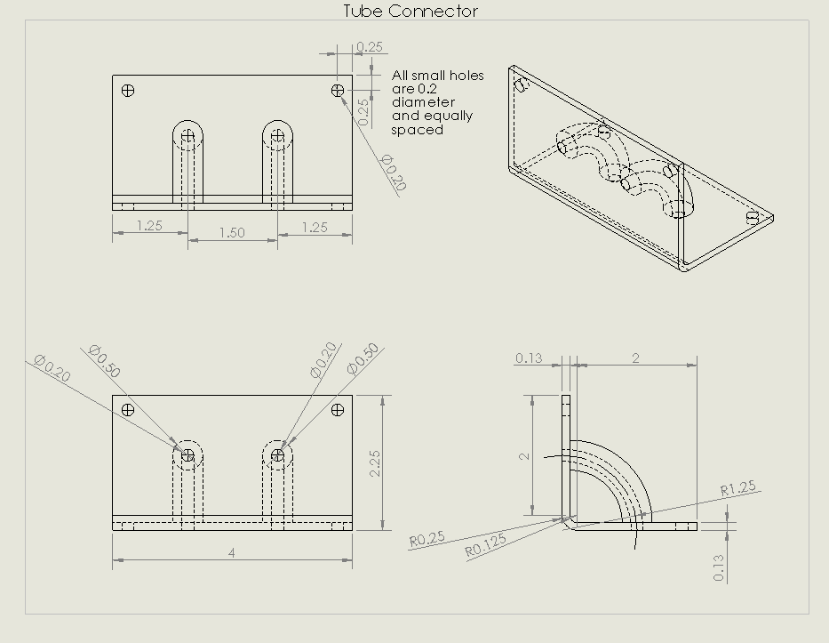
Challenge Exercise

