Slide 1

Printable Programming
Functions

Slide 2
Assignment Review

Slide 3
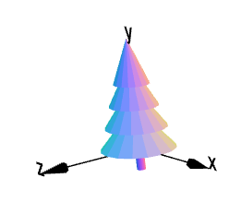
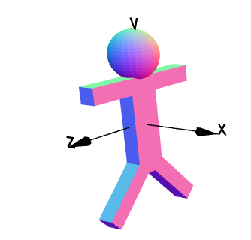
Functions in CADjs

Slide 4
Lets Start with the Human
body = cube(1,6,2);
head= sphere(1.5).translate(0,4.25,0);
rightLeg= cube(1,4,1).rotateX(45).translate(0,-4,-
leftLeg= cube(1,4,1).rotateX(-45).translate(0,-4,2);
hands = cube(1,1,8).translate(0,2.5,0);
h = body.union(head).union(rightLeg).union(leftLeg).union(hands);
h.display();

Slide 5
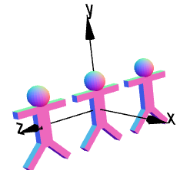
Duplicates
Must cut and paste code multiple copies

Slide 6
Functions to the Rescue
function human() {
var body, head, rightLeg,leftLeg,hands,g;// declare variables
body = cube(1,6,2);
head= sphere(1.5).translate(0,4.25,0);
rightLeg= cube(1,4,1).rotateX(45).translate(0,-4,-
leftLeg= cube(1,4,1).rotateX(-45).translate(0,-4,2);
hands = cube(1,1,8).translate(0,2.5,0);
g = body.union(head).union(rightLeg).union(leftLeg).union(hands);
return g;
}
h=human();
h.display();

Slide 7
Quickly make Duplicates
h=human().display();
h1=human().translate(0,0,10).display();
h2=human().translate(0,0,-10).display();

Slide 8
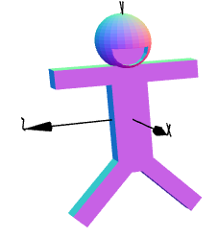
Lets Give our Friend a Smile
function human(smile) {// smile = 1 or 0
… rest of code same as before
if (smile == 1) {
var s1, s2;
s1=cylinder(1,1).rotateZ(90);
s2=cube(2,2,2).translate(0,0,-1);
s1=s1.difference(s2);
s1.translate(1,0,-4).rotateX(90);
g=g.difference(s1);
}
return g;
}
h=human(1).display();

Slide 9
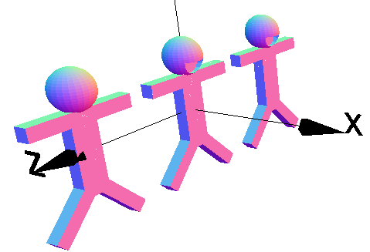
Some are Happy
h=human(1).display();
h1=human(0).translate(0,0,10).display();
h2=human(1).translate(0,0,-10).display();

Slide 10
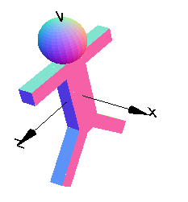
What if you forget to set parameter?
function human(smile) {// smile = 1 or 0
}
h=human().display();
Smile is assumed to be zero

Slide 11
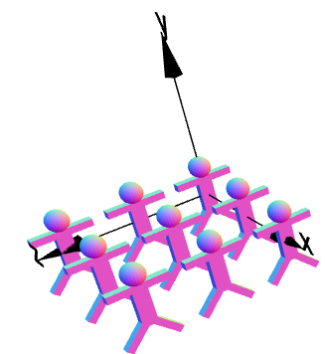
Can Even Make a Whole Group
for(i=0;i<3;i++) {
for(j=0;j<3;j++) {
h=human().translate(i*10,0,j*10)
h.display();
}
}

Slide 12
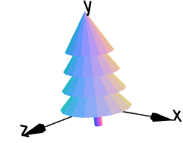
The Tree Function
function tree() {
g1=cylinder(1,10);
for(i=1;i<5;i++) {
g2=cone(10-i*,.1,10).translate(0,5*i,0);
g1=g1.union(g2);
}
return g1;
}
g=tree();
g.display();

Slide 13
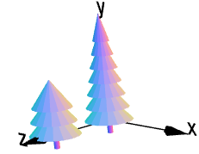
Function Parameters
What if I want trees with a different n number of sections?
function tree(n) {
g1=cylinder(1,10);
for(i=1;i<n+1;i++)
{
g2=cone(10-i,.1,10).translate(0,5*i,0);
g1=g1.union(g2);
}
return g1;
}
g=tree(7);
g1=tree(3).translate(0,0,25);
g=g.union(g1);
g.display();

Slide 14
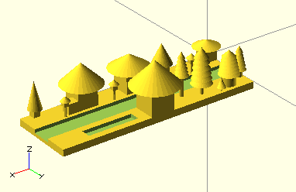
Modeling a Neighborhood
Used 4 different Fuctions:
-House
-Tree
-Street Lamp
With diffenent parameters:
-Height
-Size
-Sections
Funtions allow you to make larger, unique products.
Its a better Copy and Paste

Slide 15
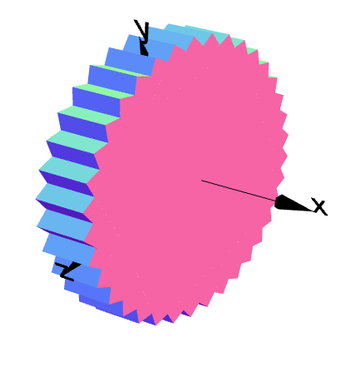
Exercise: Gear
Recreate the following code as a function to make a gear with any “n” number of teeth
gear = cube(0.25,1,1);
gear1 = gear.clone();
for (i = 0;i < 9;i++) {
gear.rotateX(10);
gear1 = gear1.union(gear);
}
gear1.display();

